Slide 1




IMPACTS ON AIRPORT ELEVATOR SYSTEM WHEN EXPOSED TO DISRUPTIVE EVENTS:
A DISCRETE EVENT SIMULATION APPROACH
Notes:
Welcome to my presentation on "Conflict Serializability" in the context of Database Management System.
My name is Chandana Galgali, and today, I will be discussing the concept of conflict serializability and its significance in ensuring the correctness and consistency of concurrent transactions.
Let's dive into the world of database management systems and explore the fascinating topic of conflict serializability.

Slide 2
Objective of the Paper
The primary goal of the paper is to evaluate how disruptive events (DE) such as temporary elevator system failures influence airport operational areas, specifically the waiting and circulation zones around elevators. It challenges the analytical design standards, which inadequately address such events, and highlights the importance of simulation-based methods for understanding bottlenecks, passenger flow, and optimal resource utilization. The study aims to inform better infrastructure design and operational strategies for resilient airport systems.
Notes:
In the world of database management systems, conflict serializability plays a crucial role in maintaining data integrity and preventing anomalies in concurrent transactions.
Conflict serializability ensures that the execution of concurrent transactions produces the same result as if they were executed sequentially.
By guaranteeing serializability, we can ensure that the final state of the database remains consistent and reflects the correct outcome of the transactions.

Slide 3
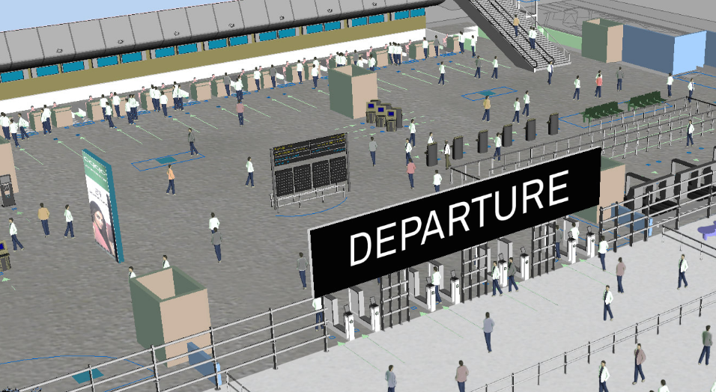
Resources Used
1. Simulation Software – ArcPORT®: A simulation tool used to model airport terminal passenger dynamics and operational scenarios. It enabled discrete event simulation to replicate real-world processes.
Notes:
It's important to understand that conflict serializability is just one aspect of serializability.
Serializable schedules are those that are either conflict serializable or view serializable.
Conflict serializability ensures that the schedule is free from conflicts between operations.
View serializability ensures that the schedule produces the same results as a serial execution, considering the read and write dependencies.
Both conflict serializability and view serializability are essential for maintaining data consistency and integrity.

Slide 4
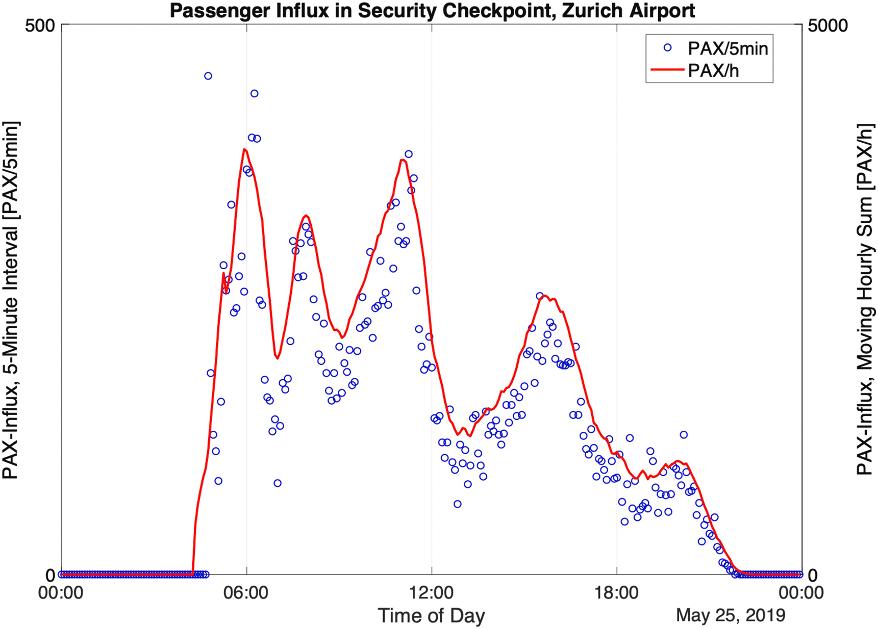
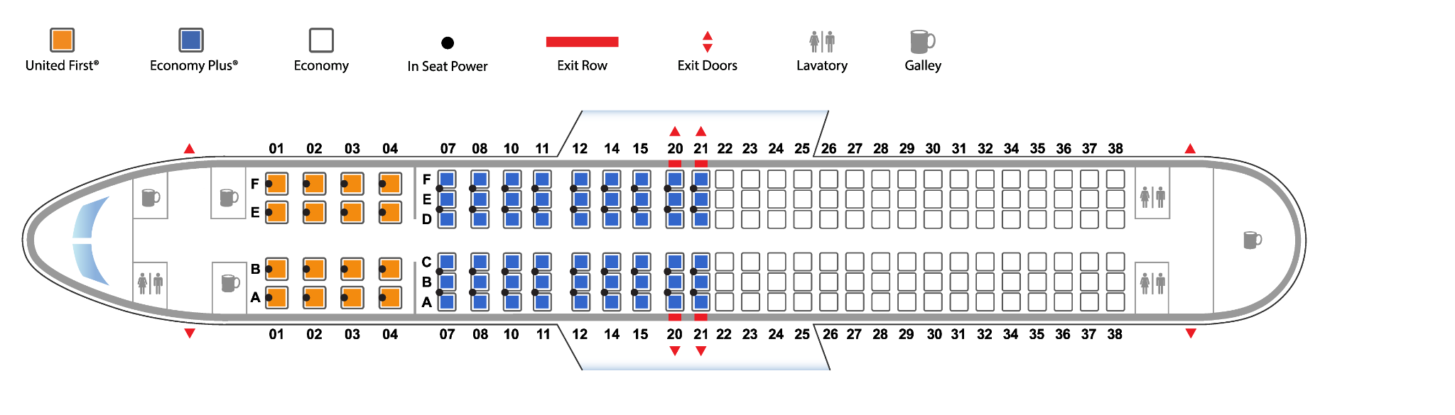

Resources Used
2. Passenger Flow Data: Simulated data derived from B737-800 operations, with each aircraft accommodating 165 passengers. This data simulated passenger influx during peak times.
Boeing 737-800
Notes:
It's important to understand that conflict serializability is just one aspect of serializability.
Serializable schedules are those that are either conflict serializable or view serializable.
Conflict serializability ensures that the schedule is free from conflicts between operations.
View serializability ensures that the schedule produces the same results as a serial execution, considering the read and write dependencies.
Both conflict serializability and view serializability are essential for maintaining data consistency and integrity.

Slide 5
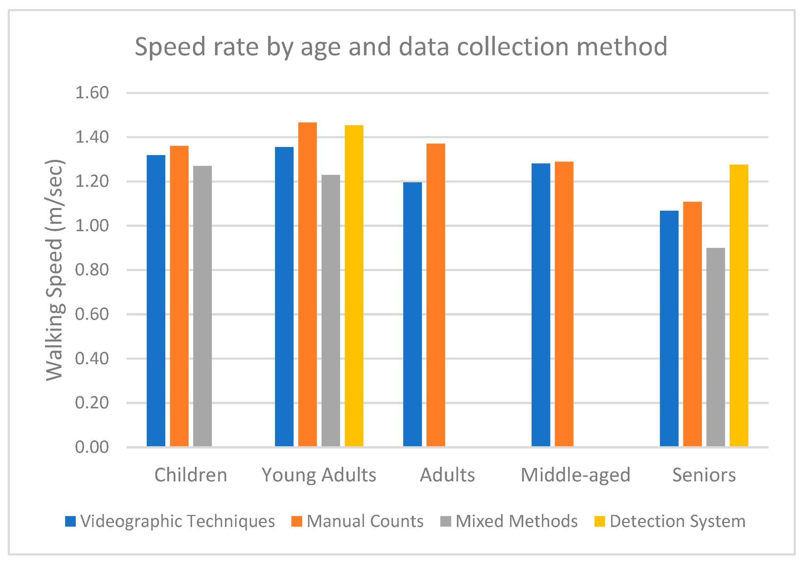
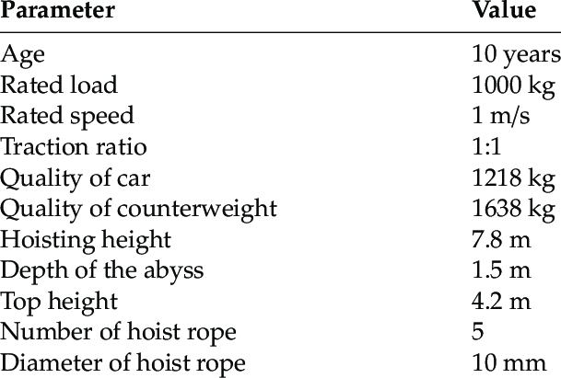
Resources Used
3. Elevator Specifications: Technical parameters like elevator dimensions, speed, and acceleration obtained from an elevator catalog.
4. Pedestrian Dynamics: Walking speed and behavior data sourced from recognized studies (Young, 1999; Zhou and Chen, 2020).
Notes:
It's important to understand that conflict serializability is just one aspect of serializability.
Serializable schedules are those that are either conflict serializable or view serializable.
Conflict serializability ensures that the schedule is free from conflicts between operations.
View serializability ensures that the schedule produces the same results as a serial execution, considering the read and write dependencies.
Both conflict serializability and view serializability are essential for maintaining data consistency and integrity.

Slide 6
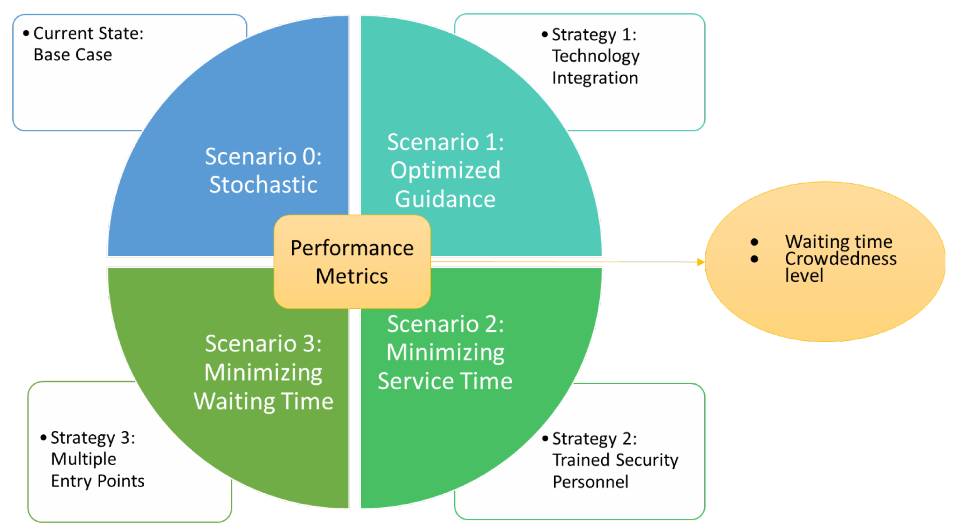
Resources Used
5. Design Guidelines: IATA’s Airport Development Reference Manual was used as a benchmark for Level of Service (LoS) standards. For example, it recommends 1 m² per passenger for an optimal LoS in arrival halls.
Notes:
It's important to understand that conflict serializability is just one aspect of serializability.
Serializable schedules are those that are either conflict serializable or view serializable.
Conflict serializability ensures that the schedule is free from conflicts between operations.
View serializability ensures that the schedule produces the same results as a serial execution, considering the read and write dependencies.
Both conflict serializability and view serializability are essential for maintaining data consistency and integrity.

Slide 7
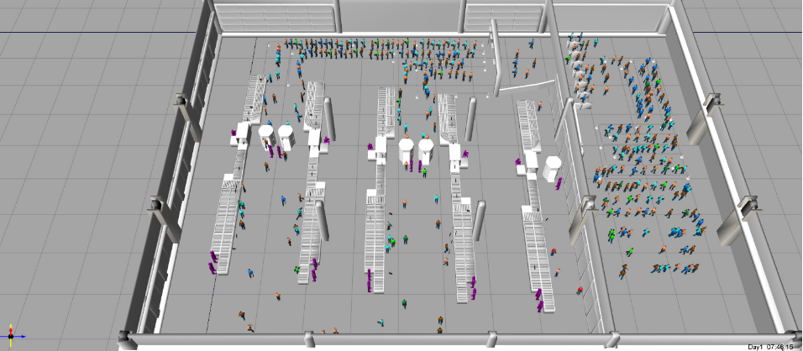

Algorithm/Simulation/Modeling Used
Discrete Event Simulation (DES) Approach:
Model Configuration:
The simulation modeled the terminal's arrivals hall, baggage claim floor, and two elevators connecting the floors.
Notes:
To understand conflict serializability, let's first grasp the concept of serializability itself.
Serializability refers to the property of a schedule in which the execution of concurrent transactions appears as if they were executed sequentially, one after another.
It ensures that the final state of the database remains consistent and reflects the correct outcome of the transactions.
A schedule is a sequence of operations from different transactions, and it can be represented as a timeline.

Slide 8
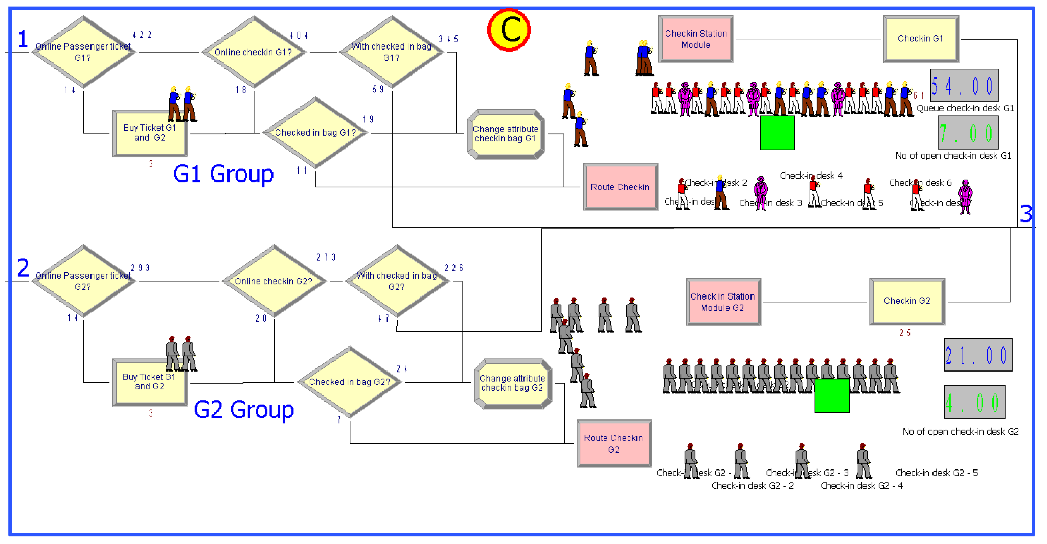
Algorithm/Simulation/Modeling Used
Discrete Event Simulation (DES) Approach:
Passenger Flow Simulation: Arrival curves replicated peak periods using flight schedules and passenger disembarkation data. All passengers were assumed to use elevators.
Notes:
To understand conflict serializability, let's first grasp the concept of serializability itself.
Serializability refers to the property of a schedule in which the execution of concurrent transactions appears as if they were executed sequentially, one after another.
It ensures that the final state of the database remains consistent and reflects the correct outcome of the transactions.
A schedule is a sequence of operations from different transactions, and it can be represented as a timeline.

Slide 9

Algorithm/Simulation/Modeling Used
Discrete Event Simulation (DES) Approach:
Disruptive Events: Events with varying durations (5, 10, 15, 20, 25, and 30 minutes) simulated elevator failures. A baseline scenario with no disruptions (NO DE) was also included.
Notes:
To understand conflict serializability, let's first grasp the concept of serializability itself.
Serializability refers to the property of a schedule in which the execution of concurrent transactions appears as if they were executed sequentially, one after another.
It ensures that the final state of the database remains consistent and reflects the correct outcome of the transactions.
A schedule is a sequence of operations from different transactions, and it can be represented as a timeline.

Slide 10
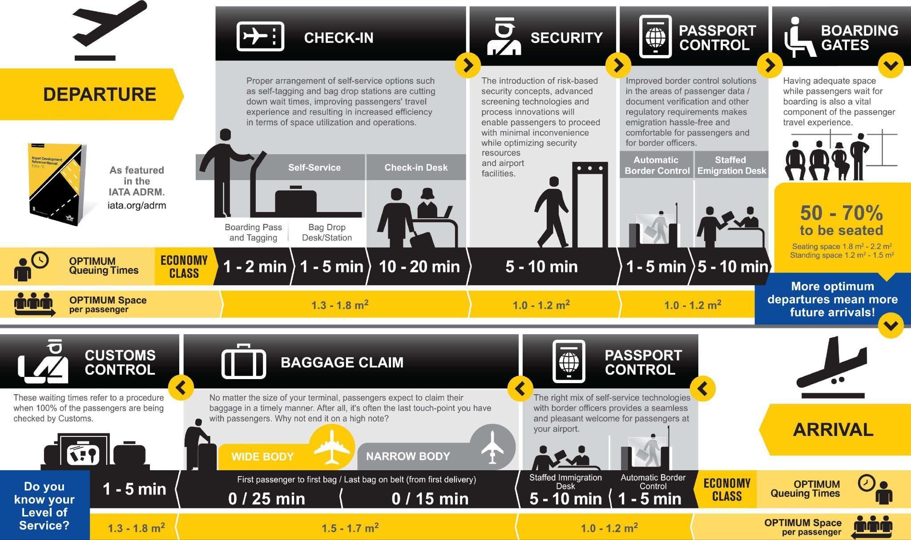
Algorithm/Simulation/Modeling Used
Discrete Event Simulation (DES) Approach:
Key Performance Metrics: Passenger buildup, circulation area usage, and the deviation from IATA standards were tracked.
Notes:
To understand conflict serializability, let's first grasp the concept of serializability itself.
Serializability refers to the property of a schedule in which the execution of concurrent transactions appears as if they were executed sequentially, one after another.
It ensures that the final state of the database remains consistent and reflects the correct outcome of the transactions.
A schedule is a sequence of operations from different transactions, and it can be represented as a timeline.

Slide 11



Results
1. Passenger Accumulation:
Disruptive events caused severe passenger congestion near elevators. The longer the disruption, the greater the area required for waiting passengers, far exceeding IATA guidelines.
Notes:
Conflict serializability is a specific type of serializability that focuses on the conflicts between operations in concurrent transactions.
Conflicting operations are those that access or modify the same data item and have the potential to create interference or inconsistency.
By analyzing the conflicts between operations, we can determine if a schedule is conflict serializable.

Slide 12
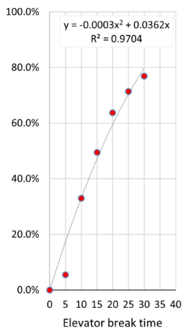
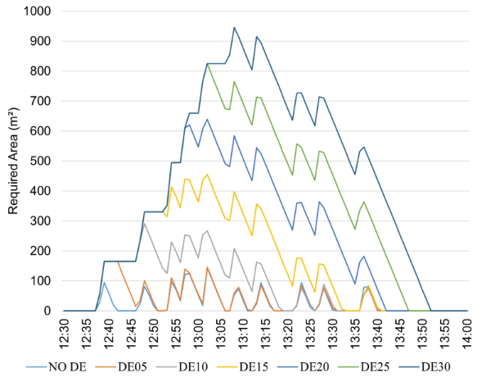
Results
2. Quantitative Insights:
Figure 1(b)
Figure 1(a): Displays the required area for each disruption scenario. Longer disruptions demand more space for accumulated passengers.
Figure 1(b): Shows the percentage of time the passenger area exceeded IATA's recommendations during normal and disrupted operations.
Figure 1(a)
Notes:
Conflict serializability is a specific type of serializability that focuses on the conflicts between operations in concurrent transactions.
Conflicting operations are those that access or modify the same data item and have the potential to create interference or inconsistency.
By analyzing the conflicts between operations, we can determine if a schedule is conflict serializable.

Slide 13

Results
3. Prediction Accuracy: The DES model effectively predicted the degree and location of bottlenecks caused by disruptions, which analytical models overlooked.
Notes:
Conflict serializability is a specific type of serializability that focuses on the conflicts between operations in concurrent transactions.
Conflicting operations are those that access or modify the same data item and have the potential to create interference or inconsistency.
By analyzing the conflicts between operations, we can determine if a schedule is conflict serializable.

Slide 14
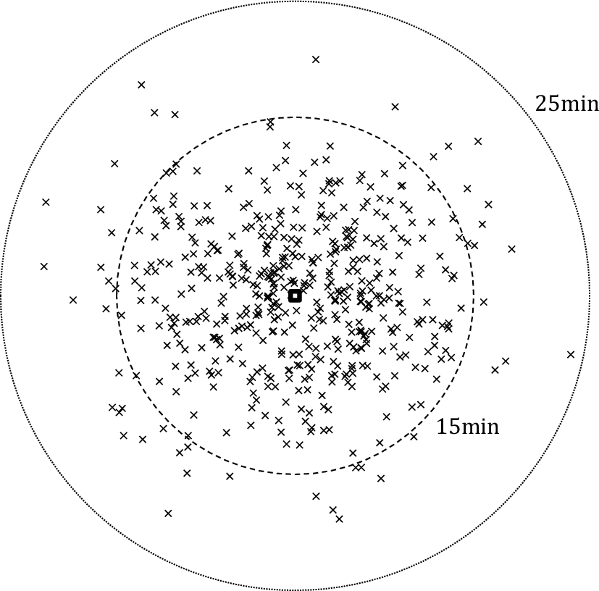
Inferences
Critical Findings:
Disruptive events disrupt the equilibrium between passenger flow and infrastructure capacity, leading to operational inefficiencies.
Waiting and circulation areas require dynamic sizing strategies, especially in systems prone to failures.
Notes:
In conclusion, conflict serializability is a crucial concept in database management systems to ensure the correctness and consistency of concurrent transactions.
By analyzing conflicts between operations using precedence graphs, we can determine if a schedule is conflict serializable.
Serializable schedules are essential for maintaining data integrity and preventing anomalies in database systems.
I hope this presentation has provided valuable insights into the concept of conflict serializability in database management systems.
Here is the reference I used in preparing this presentation.
This source can be explored for further information on conflict serializability and related topics.
Thank You!

Slide 15
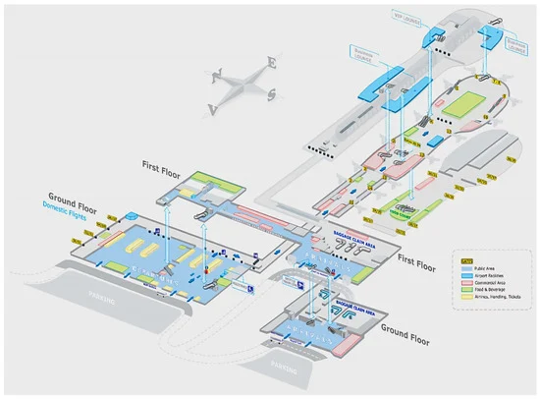
Inferences
Implications for Airport Design:
Simulation tools like DES provide actionable insights for resilient infrastructure planning, complementing static analytical methods.
Integrated approaches can better align infrastructure capacity with real-world operational challenges.
Notes:
In conclusion, conflict serializability is a crucial concept in database management systems to ensure the correctness and consistency of concurrent transactions.
By analyzing conflicts between operations using precedence graphs, we can determine if a schedule is conflict serializable.
Serializable schedules are essential for maintaining data integrity and preventing anomalies in database systems.
I hope this presentation has provided valuable insights into the concept of conflict serializability in database management systems.
Here is the reference I used in preparing this presentation.
This source can be explored for further information on conflict serializability and related topics.
Thank You!

Slide 16
References (IEEE Format)
1. International Air Transport Association, *Airport Development Reference Manual*, 11th ed., Montreal: IATA, 2019.
2. Transoft Solution, "ArcPORT Terminal", accessed Nov. 5, 2020.
3. S. B. Young, “Evaluation of pedestrian walking speeds in airport terminals,” *Transportation Research Record*, vol. 1674, no. 1, pp. 20–26, 1999.
4. L. Zhou and Z. Chen, “Measuring the performance of airport resilience to severe weather events,” *Transportation Research Part D: Transport and Environment*, vol. 83, p. 102362, 2020.
Notes:
In the world of database management systems, conflict serializability plays a crucial role in maintaining data integrity and preventing anomalies in concurrent transactions.
Conflict serializability ensures that the execution of concurrent transactions produces the same result as if they were executed sequentially.
By guaranteeing serializability, we can ensure that the final state of the database remains consistent and reflects the correct outcome of the transactions.

